Slide 1


Housing EDA
Logan Quandt

Slide 2
Statistical Quesiton
Is house size the main predictor in housing prices?

Slide 3
Variables Used
The Dataset chosen contains housing information from California and can be used to determine factors affecting house price. I chose the following variables.
salePrice = How much the house sold for
sqftliving = How many square feet are on the interior of the house
sqftlot = How big is the lot the house sits on
number_bedrooms = Number of finished bedrooms in the house
zipcode = Zipcode in California house is located in
YearBuilt = The Year the house was built

Slide 4
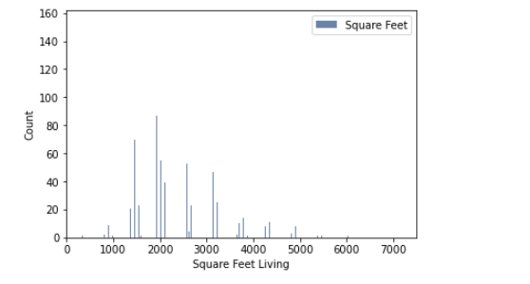
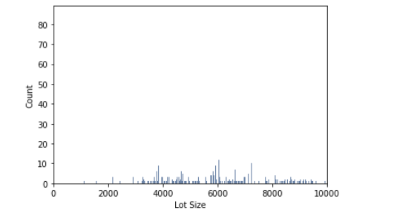
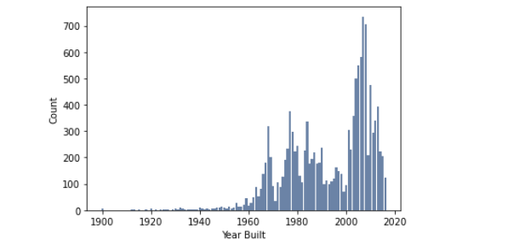
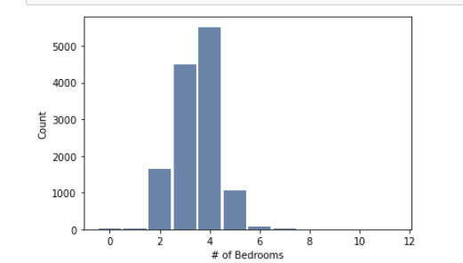
Histograms of Variables

Slide 5
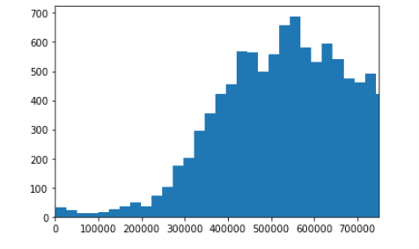
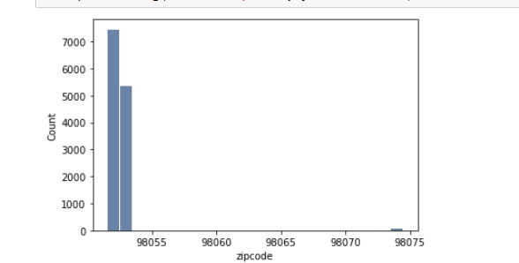
Histograms Continued

Slide 6
Histogram Analysis
The histograms and dataset show there are outliers in Sale Price with some houses selling for over $1,000,000 dollars but dropping off around the mean. There are also outliers in lot size with a few houses approaching a 10,000 sq ft lot. I believe that if we wanted an accurate description on the average house, we would exclude these likely luxury houses that would be priced differently than a normal house.

Slide 7
Summary Statistics
Mean Sale Price: 660737.7496307812
Median Sale Price: 593000
Mean Sq Ft Living: 2539.5061795569372
Median Sq Ft Living: 2420
Mean Sq Ft Lot: 22228.568208317138
Median Sq Ft Lot: 7965
Mean # of Bedrooms: 3.478663039253789
Median # of Bedrooms: 4

Slide 8
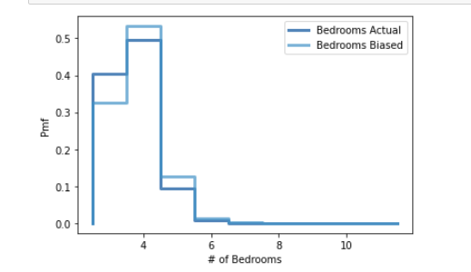
Bedrooms PMF
The Bedrooms PDF shows the actual number of bedrooms in a house that has over 2 bedrooms compared to a biased PMF.

Slide 9
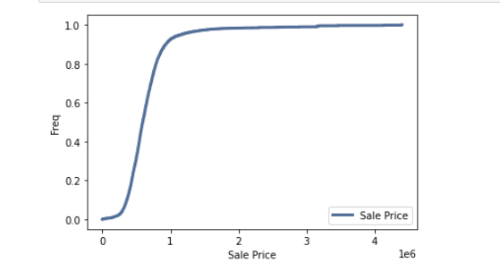
Sale Price CDF
The CDF shows the cumulative probability of a house being a certain sales price.

Slide 10
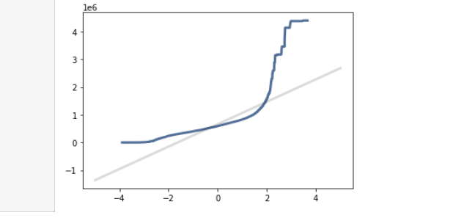
Distribution
Normal Distribution of Sale Price, it indicates a poor linear fit for the data.

Slide 11
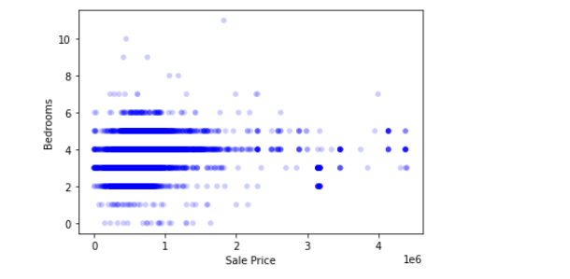
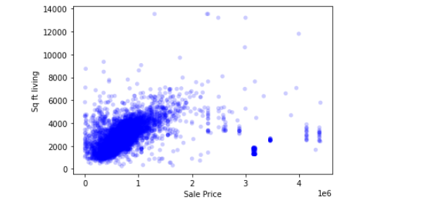
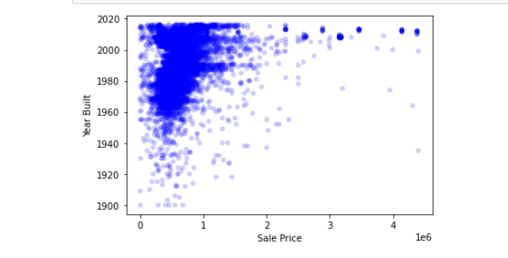
Scatterplots

Slide 12
Correlation, Covariance, Pearson and Spearman’s
The correlation between sale price and number of bedrooms is 0.22.
The correlation between sale price and living space is 0.45.
The Spearman Correlation between sale price and living space is 0.70.
The Spearman Correlation between sale price and bedrooms is 0.40.
These indicate there is a positive correlation between bedrooms and living space to sale price. The correlation is not very strong. The Spearman correlations are stronger perhaps to due accounting for outliers.

Slide 13
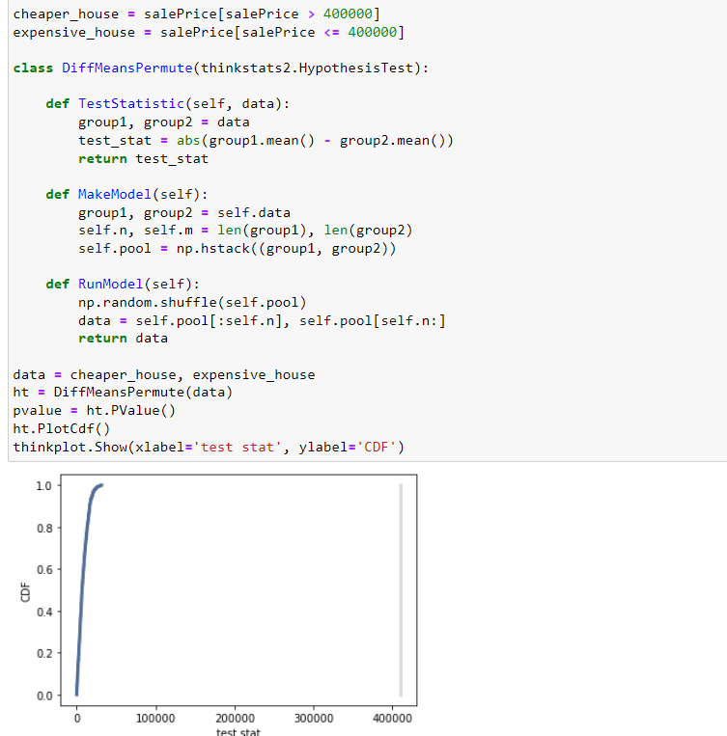
Hypothesis Test
Conducted a hypothesis test between means of cheaper houses compared to expensive houses.

Slide 14
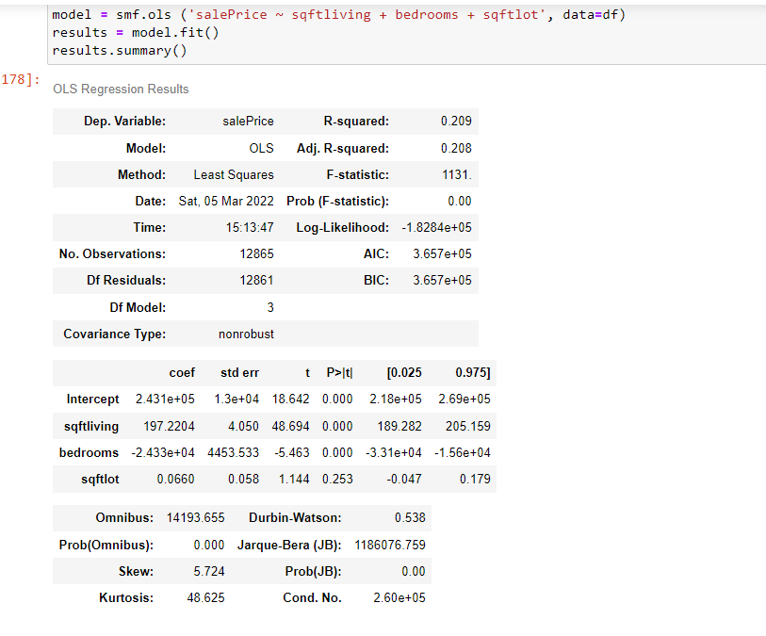
Regression
The P values being 0 for sqftliving and bedrooms indicate they do not intersect the cdf. The R squared value indicated 20.9% of the data fit the regression model. The p value of sqftlot indicates it is not statistically significant.

Slide 15
Conclusion
Based on my analysis there does not appear to be a strong correlation between house size (either bedrooms, living space or lot size) with sale price. However, the living space has a much stronger Spearman Correlation which could indicate that the relationship is non-linear and affected by outliers.
Therefore, I failed to prove or disprove my hypothesis.

